Slide 1
New treatments for headache
Mark Weatherall
BASH meeting, Belfast, November 2022

Slide 2
Disclosures
I have received honoraria for lecturing and advisory board work from Novartis, TEVA Pharmaceuticals, Eli Lilly & Co, Biohaven, Lundbeck, Pfizer and Allergan/Abbvie
I am on the scientific advisory board of Sapphire Medical Clinics

Slide 3
Lecture outline
Discovery of CGRP & its role as a vasodilator
The role of CGRP in migraine
The fate of the first generation CGRP antagonists (gepants)
CGRP monoclonal antibodies
Second generation gepants
Future directions

Slide 4

Ware 1980s: old and new treatments
In the early 1980s, the head of Allen & Hanburys, David Jack, recruited a pharmacologist called Patrick Humphrey to run a migraine project
A&H were focussed on finding new treatments for common conditions with limited existing treatment options
Humphrey’s starting point was Wolff’s work on extracranial arteries
  “… we ordered a whole lot of stuff to look at isolated blood vessels and what we started on doing was the rabbit ear artery, because ostensibly that’s a cranial vessel, extracranial, it was easy to get out and it was easy to put a catheter into it…”
Humphrey discovered a new 5-HT receptor on the dog saphenous vein
  this receptor was believed to be present in anastomotic shunts in the cerebral circulation, which were thought to be important in migraine pathogenesis (Saxena)

Slide 5

From methysergide to the first triptan
studies of the LSD derivate methysergide in the 1960s and 1970s (many done by James Lance in Australia) had suggested the importance of a whole family of serotonin receptors in migraine pathogenesis
Humphrey found that methysergide constricted vessels in his model
having started unsure whether 5-HT or prostaglandins would be his many area of interest, he abandoned the latter, and concentrated on creating novel serotonin subtype agonists, using the dog saphenous vein to test candidate molecules
one product (GR43175) proved to have excellent antimigraine properties; this was eventually marketed as Imigran (sumatriptan)

Slide 6

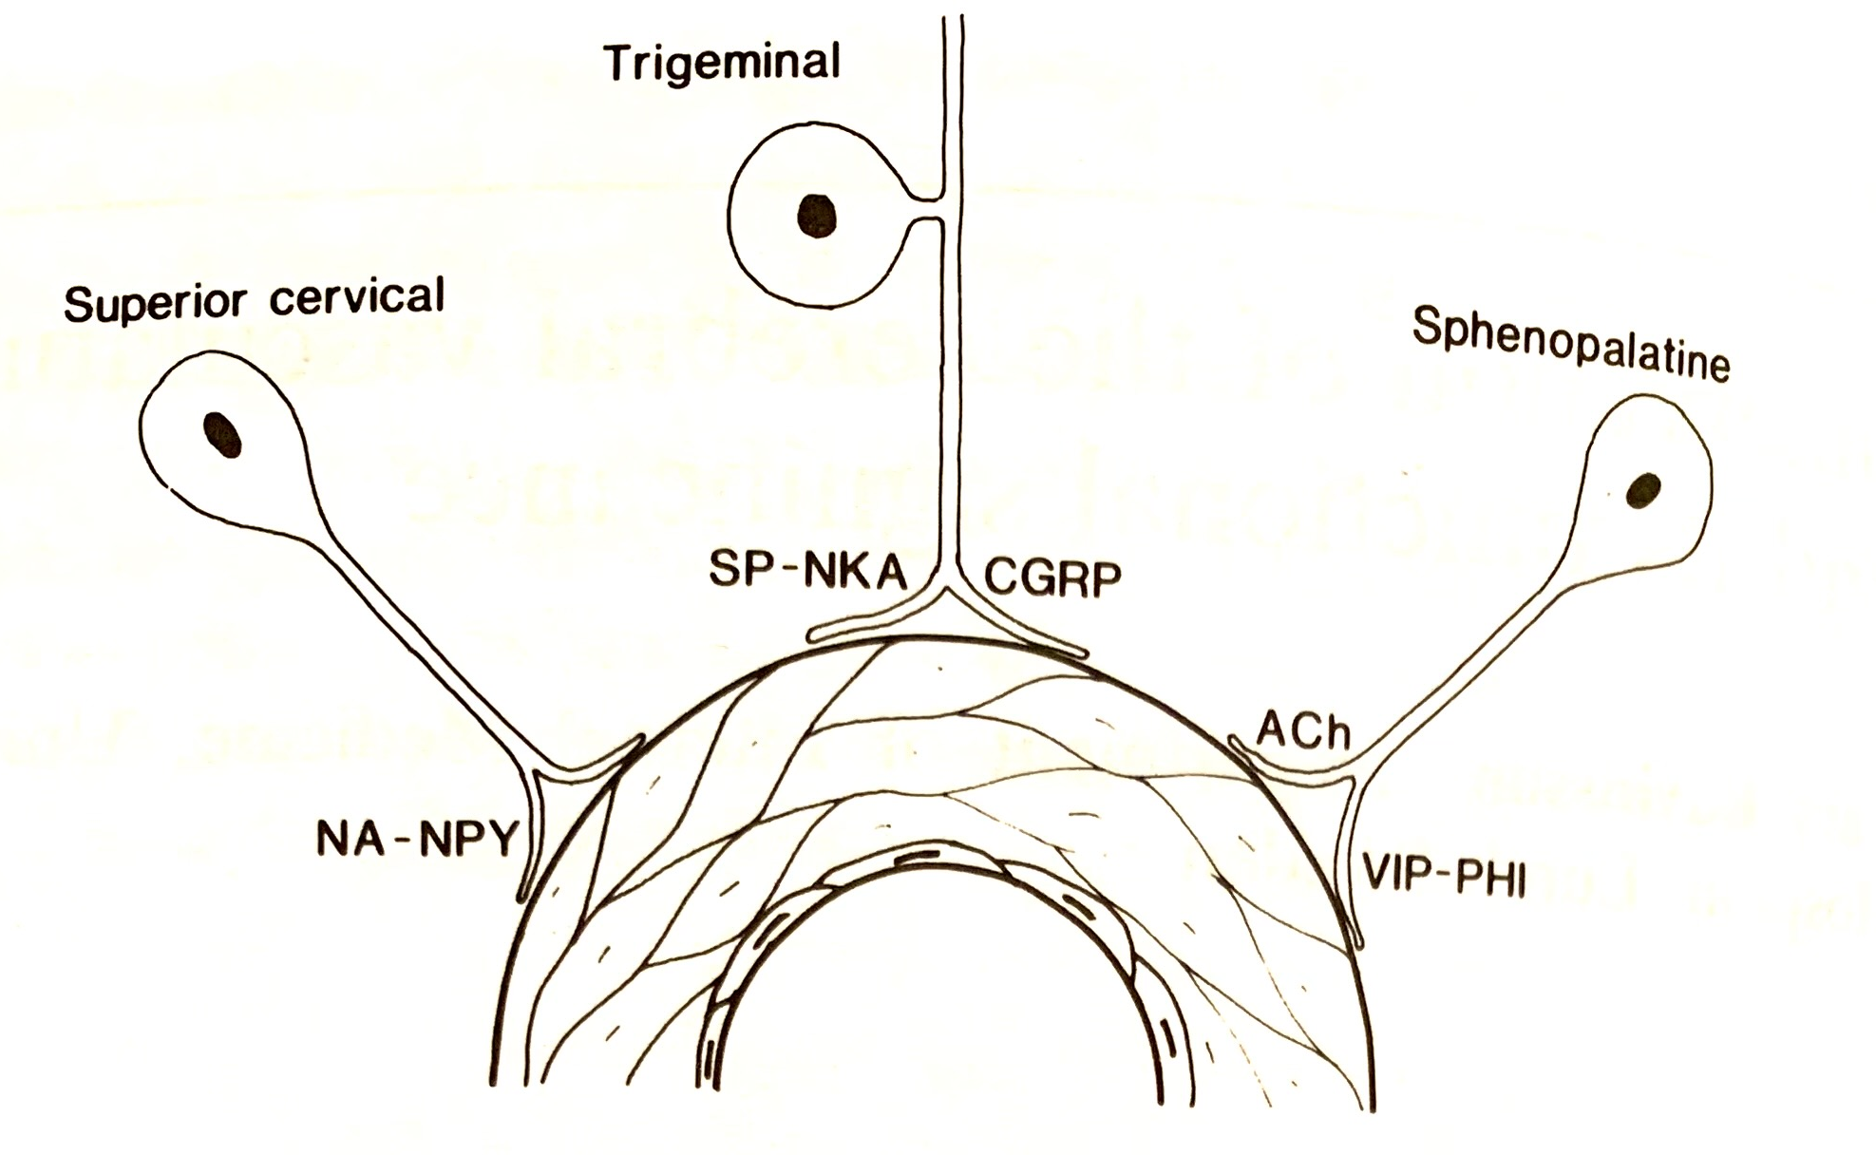
New views of cerebral innervation
Edvinsson developed novel techniques for assessing functional contractility in small arteries with intact endothelium
experiments with pial arteries (obtained during lobe resections) showed adrenergic alpha-receptors (mediating contraction) and beta-receptors (dilation), cholinergic muscarinic receptors (dilation) and histamine H2-receptors (mediating dilation); vasoconstriction could be induced by 5-HT (blocked by methysergide)
using immunohistochemical techniques, other peptides were found in cerebrovascular nerves: vasoactive intestinal peptide (VIP) (1976); substance P (1981); neuropeptide Y (1983); CGRP (1985); neurokinin A (1986)

Slide 7
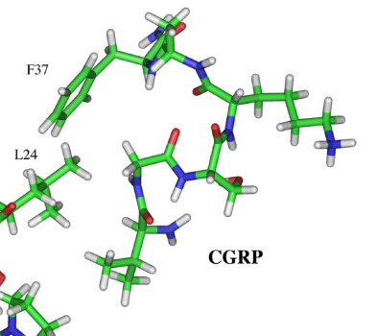
Calcitonin gene-related peptide
in 1982 a paper in Nature suggested that alternative mRNA processing of the calcitonin gene could produce calcitonin or a predicted 37- amino acid product called calcitonin gene-related peptide (CGRP)
  calcitonin mRNA was found to predominate in the thyroid, while CGRP mRNA was found in the hypothalamus
in 1983 CGRP was identified immunocytochemically, and found to be distributed throughout the CNS and PNS
in 1984, large quantities were found in the rat trigeminal ganglion, co-localising with substance P
in 1985, CGRP was shown to be a potent vasodilator
  “local extravascular release of CGRP may be involved in the physiological control of blood flow and that circulating CGRP may contribute to hyperaemia in certain pathological conditions”

Slide 8
Edvinnson on CGRP
Edvinsson almost immediately recognised that CGRP might be an important novel neuropeptide
in work first presented at an INSERM CNRS congress on regulatory peptides in Paris in 1984, he demonstrated perivascular CGRP-containing nerves, and potent vasodilatation of cerebral arteries by CGRP

Slide 9
Edvinsson on CGRP
CGRP postulated to be an ‘antivasoconstrictor’ substance – responsible e.g. for the restoration of vascular diameter following SAH-induced vasoconstriction
its presence in the trigeminal ganglion raised intriguing possibilities about its role in the trigeminovascular system, and in turn its potential relevance to migraine

Slide 10

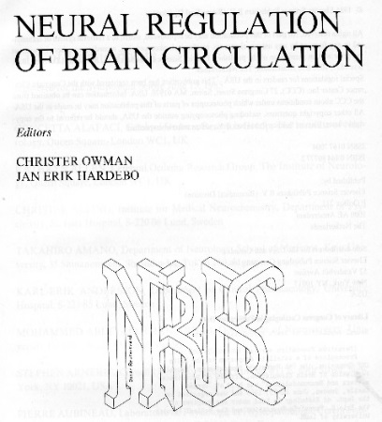
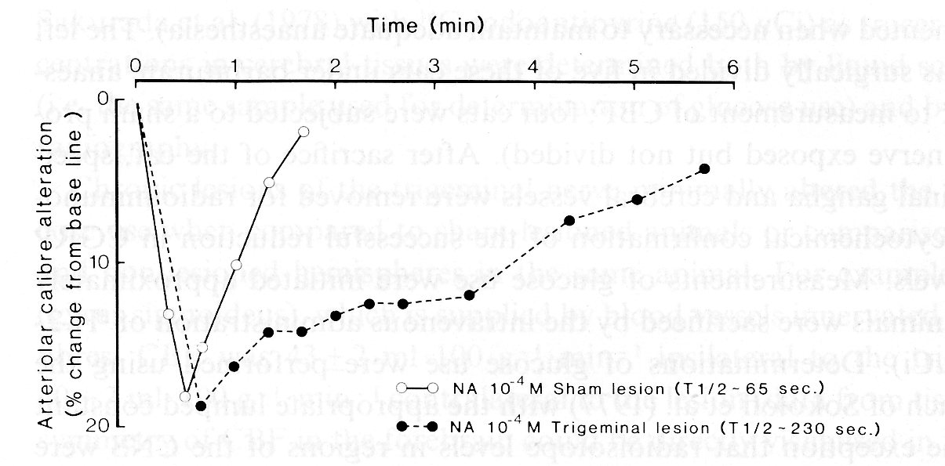
Enter the antipodean
in 1985, Edvinsson was lecturing at a meeting at Örenäs castle, a satellite to the meeting of the International Cerebral Blood Flow and Metabolism Society (Brain ‘85) which was being held in Ronneby, Sweden
Edvinsson was approached afterwards by Peter Goadsby, an Australian neurologist, who had trained with James Lance
Goadsby: “I was struck particularly by a figure – later published in the book, and the compelling attention to detail.”
Sweden, June 1985

Slide 11
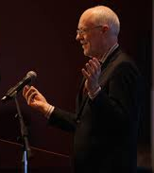
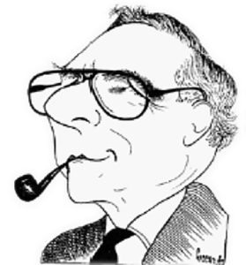


James Lance & Peter Goadsby
Lance: “the guiding light of my research and clinical career has been to try to explain clinical phenomena in physiological terms and apply that to treatment”
first paper was observation of 500 patients with migraine
clinical trials of methysergide, leading to multiple studies of serotonin metabolism in migraine
in mid-1970s, increasing interest in carotid blood flow in migraine
Peter Goadsby’s initial work focussed on the locus coeruleus
  “activation of the trigeminal system increases carotid blood flow by a pathway involving the seventh cranial nerve, the GSP [greater superficial petrosal] and Vidian nerves, and a parasympathetic synapse employing an unconventional transmitter”
Locus coeruleus stimulation increases cranial blood flow
VII cut

Slide 12
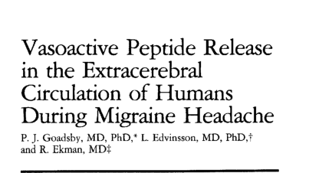
CGRP release in pain & primary headache disorders
Edvinsson & Goadsby’s first collaboration (Ann Neurol 1988) demonstrated CGRP and substance P release in patients undergoing thermocoagulation as treatment for trigeminal neuralgia
  in patients who flushed there were marked elevations of the local (cranial) levels of both peptides. However, in the nonflushing patients no changes in the peptide levels were observed.
further studies looked at venous blood sampled from external jugular and cubital fossa ipsilateral to the side of headache in patients with migraine
  plasma levels of neuropeptide Y, vasoactive intestinal polypeptide, substance P, and calcitonin gene-related peptide were determined using sensitive RIAs
  a substantial elevation of CGRP was seen in external jugular but not cubital fossa blood in migraine attacks
  the other peptides measured were unaltered

Slide 13
Strands come together: the effect of sumatriptan on CGRP
in 1993, Edvinsson & Goadsby published further studies on the trigeminovascular system in humans and cats (Ann Neurol)
  stimulation of trigeminal ganglion led to a frequency-dependent increase in cerebral blood flow, with a marked reduction in these responses by 50% after administration of sumatriptan or dihydroergotamine.
  trigeminal ganglion stimulation also led to a release into the cranial circulation of CGRP, these increases also being markedly antagonized by both sumatriptan and dihydroergotamine.
  human studies, conducted as part of an evaluation of sumatriptan for the treatment of acute migraine, showed that in 7/8 patients responding to subcutaneous sumatriptan, elevated CGRP levels (60 +/- 8 pmol/L) were normalized, with the headache being relieved (40 +/- 8 pmol/L)

Slide 14
Infusion of CGRP induces migraine
it was not entirely clear whether the presence of elevated levels of CGRP in venous blood in migraine attacks indicated a causative role for CGRP in migraines, or was an epiphenomenon
This question was (largely) settled by studies of the effect of CGRP infusions given to patients with migraine
this work was done by Jes Olesen’s group in Copenhagen
  according to Edvinsson, Olesen had initially been sceptical about CGRP, but he came to play pivotal roles in this and other subsequent research on the role of CGRP in migraine

Slide 15
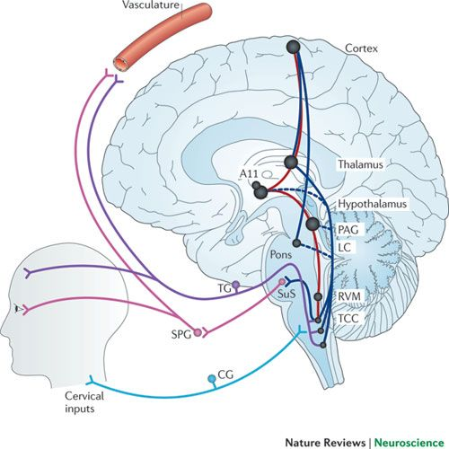
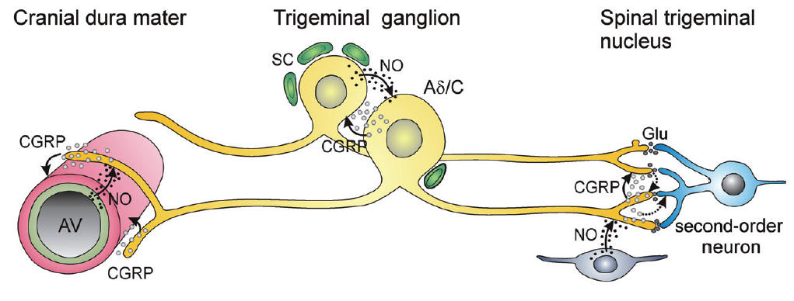
CGRP: sites of action

Slide 16
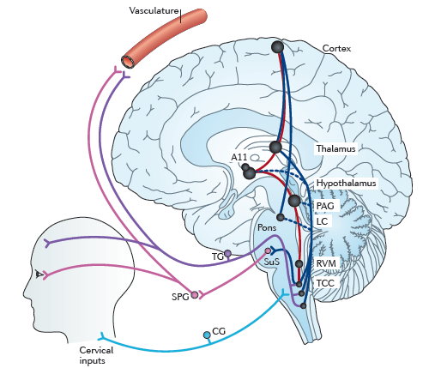
Migraine physiology
activation of the trigeminocervical complex leads to neurogenic plasma extravasation, mast cell degranulation, platelet aggregation around dural & meningeal blood vessels via release of substance P, CGRP, and VIP, but not all of these are relevant for migraine
pain signals feedback along this loop to the trigeminal nucleus caudalis
extracranial vasodilation is an epiphenomenon

Slide 17
Migraine physiology
dysfunctional descending modulatory pathways fail to damp down the increased activity in the TCC/SPG/vascular/TG loop
ascending pathways connecting the TCC, brainstem nuclei, hypothalamus, thalamic and cortical structures become activated, and are all involved in pain processing in migraine

Slide 18
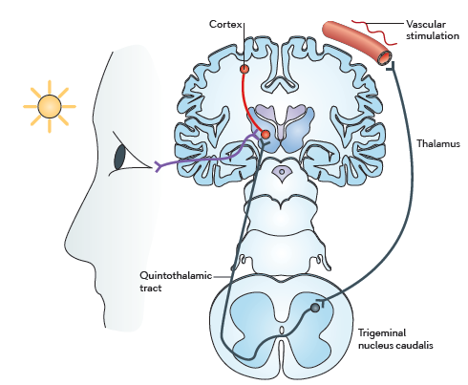
Migraine physiology
thalamic nuclei receive input from TCC and provide output to cortex (somatosensory, visual, associative)
they also receive direct input from axons originating in retinal ganglion cells, which may be the basis of photophobia

Slide 19
CGRP antagonists
BIBN4096BS: a specific & potent CRGP receptor antagonist
safety & tolerability studies showed well tolerated
it did not affect cerebral or systemic haemodynamics in healthy volunteers
animal studies showed dose-dependent inhibition of activity in the trigeminocervical complex evoked by electrical stimulation of the superior sagittal sinus; the maximal effect was seen within 30 min of administration

Slide 20
CGRP antagonists
international multicentre DBRPC ‘proof-of-concept’ trial published in NEJM in 2004
  126 patients 18-65, 1-6 migraine/month, all white) treated with placebo or BIBN4096BS
  doses between 0.25 mg & 10 mg IV used
BIBN4096BS was christened olcagepant

Slide 21
Was the future to be ‘pants’?
phase II study of oral CGRP antagonist MK-0974 (subsequently telcagepant) presented at IHS 2007 and published in Neurology in 2008
multicentre phase III RPCDBT of oral telcagepant 150 or 300 mg vs zolmitriptan 5 mg and placebo was published in The Lancet in December 2008

Slide 22
Pants are dead... long live gepants?
olcegepant and telcegepant are dead; the former for commercial reasons, the latter killed in Phase IV studies where it was shown to cause significant derangement of liver function in a small number of users
  olcegepant has had an afterlife as a laboratory tool
another CGRP antagonist MK-3207 was also dropped because of concerns re hepatotoxicity
however, as we will see, a second generation of gepants have successfully and safely made it through the clinical trial process

Slide 23
CGRP antibodies
while CGRP antagonist development was proceeding, other approaches to CGRP blockade were being considered
  first patent for use of CGRP antibody to treat migraine was filed in 2005
first clinical trials were initiated in 2011
between 2014-16 four mAbs were shown to be effective in Phase II trials
  phase III trials were published between 2017-2020 for all four mAbs
FDA approval was granted for erenumab (Aimovig) in June 2018
  all three further mAbs have been licensed in the USA and Europe
erenumab, fremanezumab, and galcanezumab have been approved for use on the NHS in the UK under certain stipulations

Slide 24
CGRP antibodies

Slide 25
Phase II studies – episodic migraine
Galcanezumab
Eptinezumab

Slide 26
Phase II studies – episodic migraine
Fremanezumab
Erenumab

Slide 27
CGRP antibodies – chronic migraine
Smith J et al, Headache 2017;57:130
Tepper S, et al Lancet Neurol. 2017;16(6):425-34.
Silberstein SD, et al N Engl J Med. 2017;377(22):2113-22.
Detke HC et al, Headache 2017;57:1336-7
Aurora SK, et al Headache. 2011;51(9):1358-73.
Silberstein SD, et al Headache. 2007;47(2):170-80.
I am grateful to Dr Manjit Matharu for this slide.

Slide 28
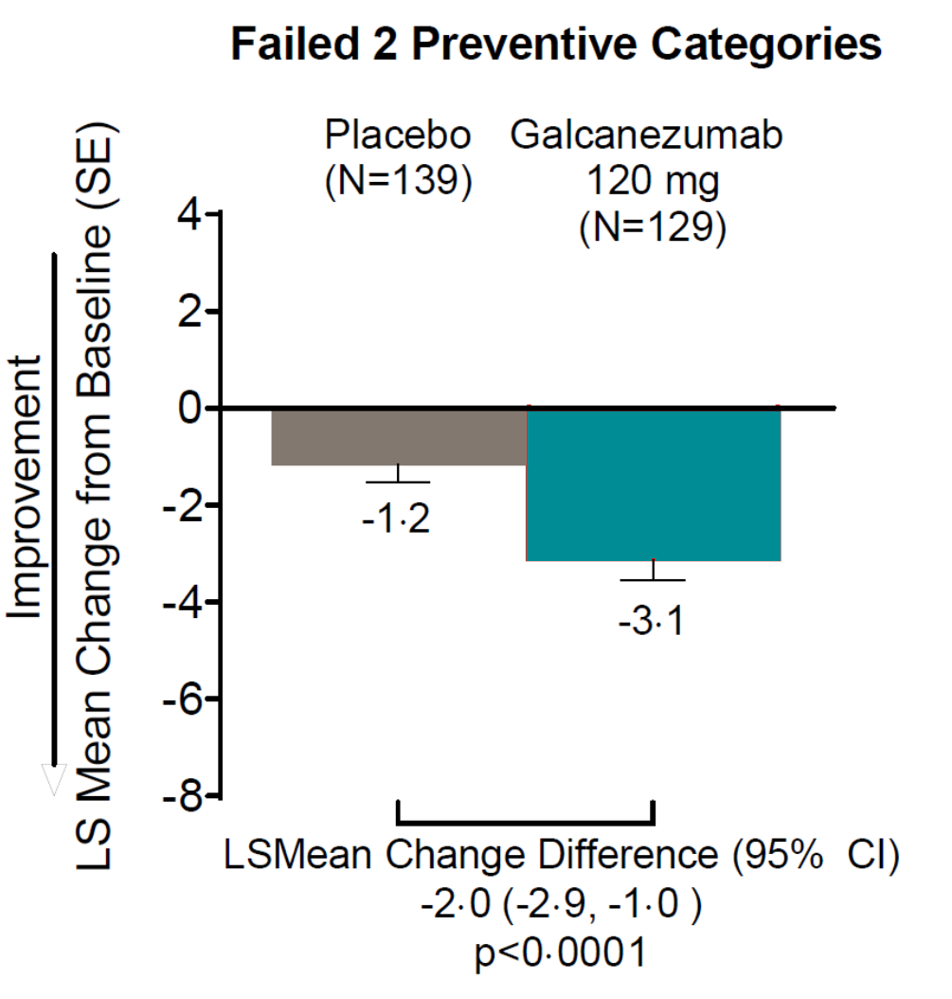
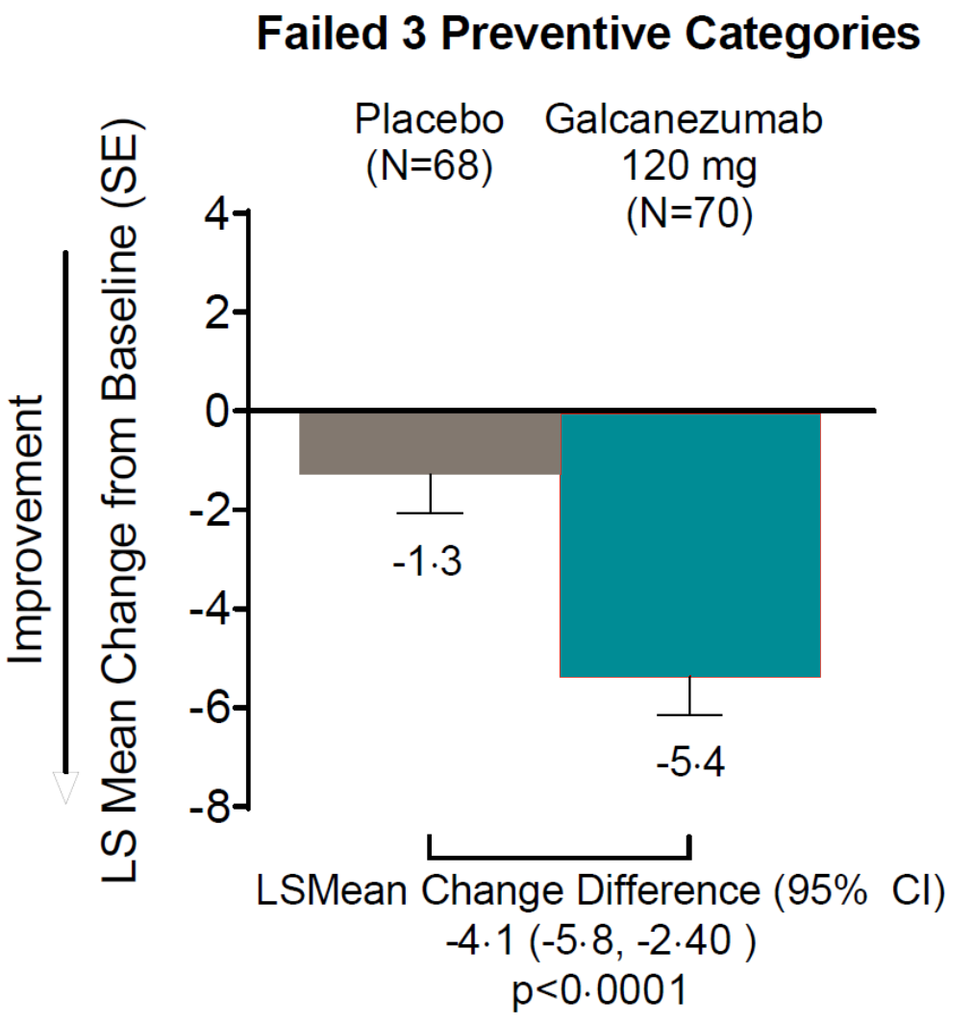
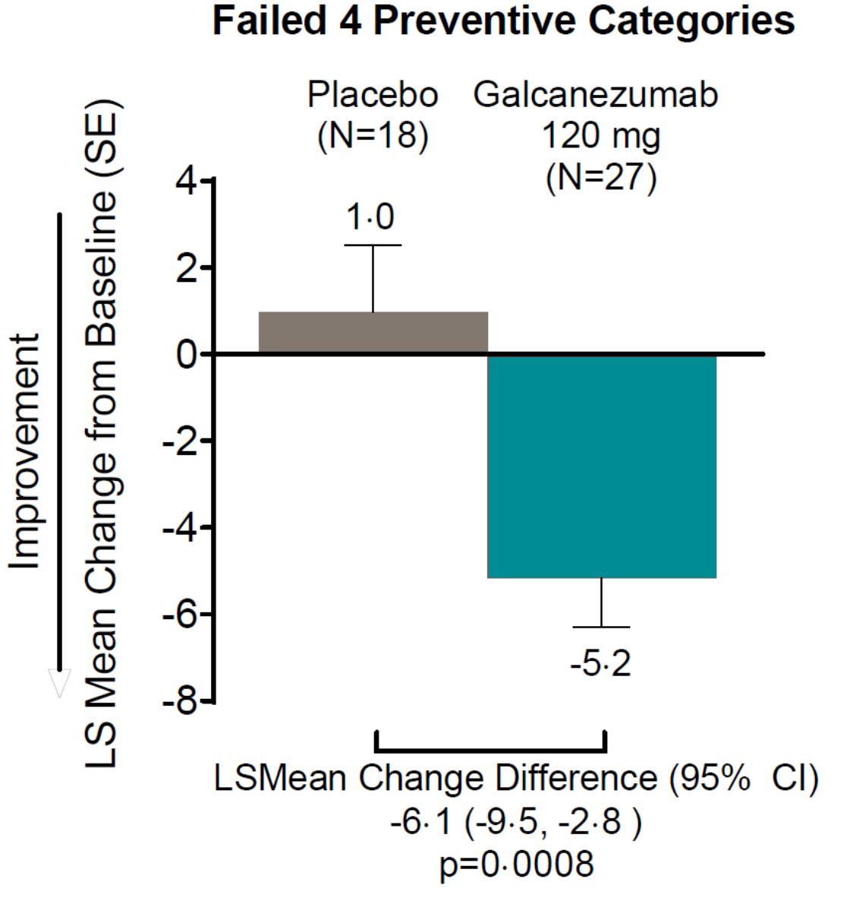
CGRP mAbs – difficult to treat patients
Mulleners WM et al. Safety and efficacy of galcanezumab in patients for whom previous migraine preventive medication from two to four categories had failed (CONQUER): a multicentre, randomized, double-blind, placebo-controlled, phase 3b trial. The Lancet Neurology, 2020, 19(10), pp.814-825.

Slide 29
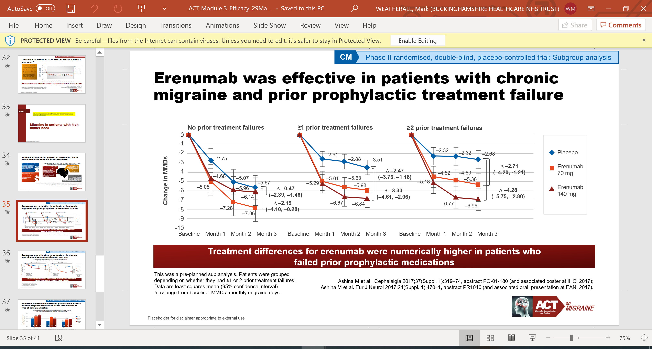
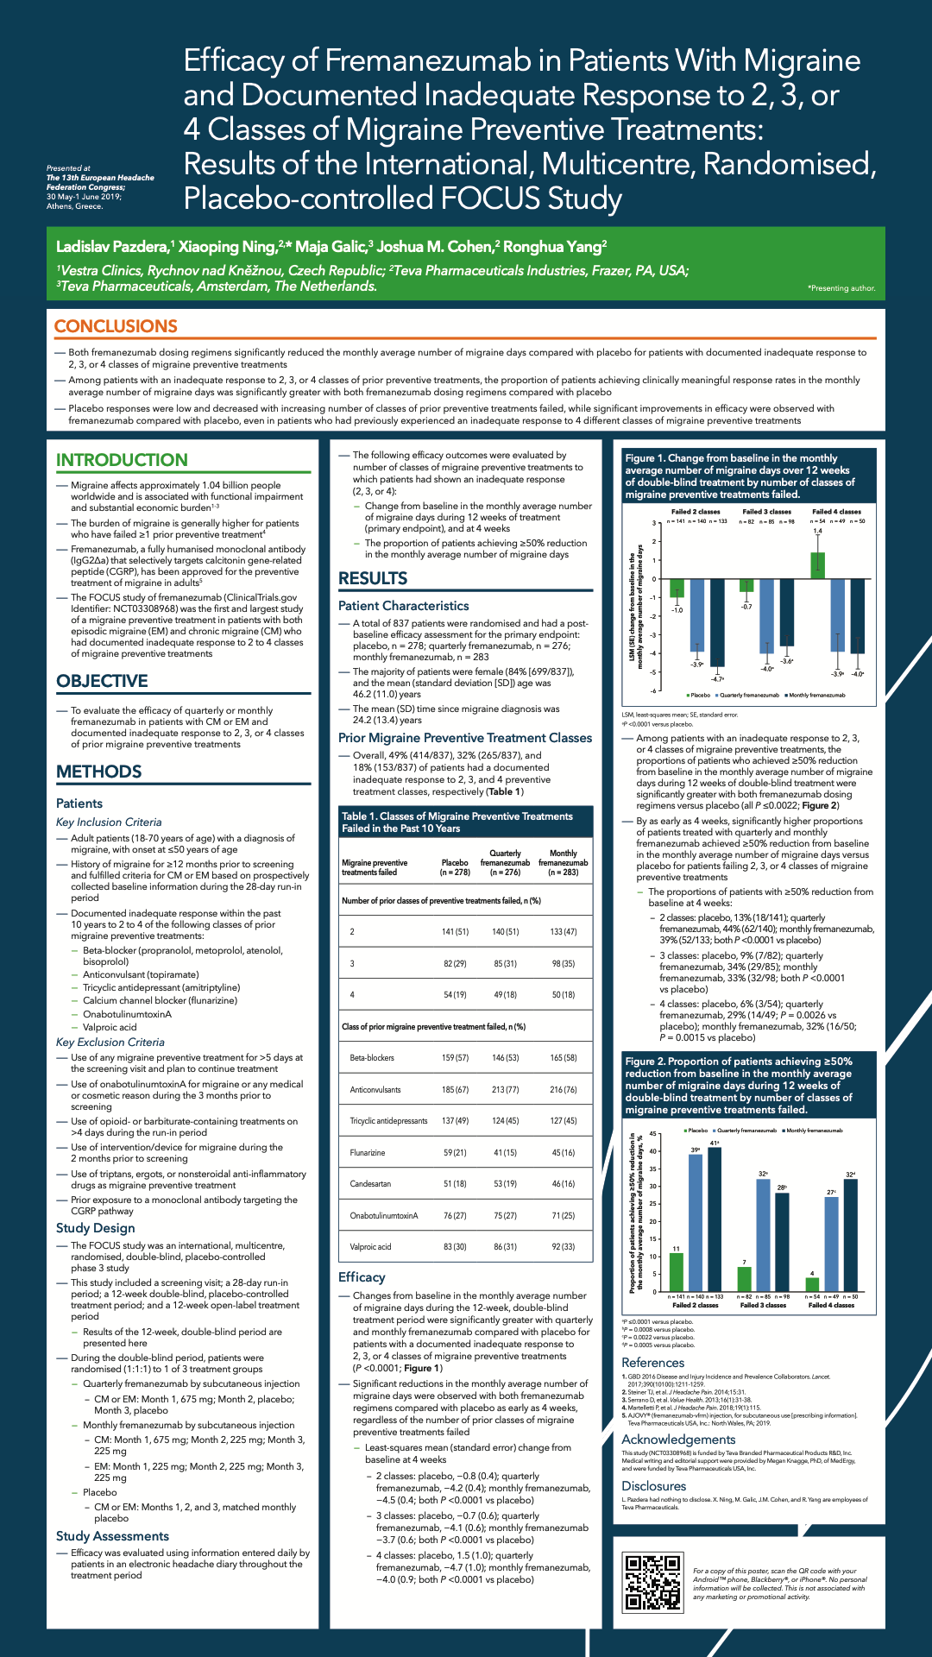
CGRP mAbs – difficult to treat patients
Ashina M et al (2018), Cephalalgia 38:1611-21.
Ferrari et al. Lancet Neurol. 2019; 6736(19): 31946-4

Slide 30
CGRP antibodies – safety & side effects
safety: no changes in
  blood pressure/heart rate/ECG
    no findings in efficacy studies - no change in treadmill test with erenumab 140 mg IV
  laboratory tests – specifically no liver function abnormalities
adverse events
  injection site reactions
  nasopharyngeal/URTIs – constipation (can be very severe)
  single case report of stroke in temporal association with first dose of erenumab
  some reports of worsening of autoimmune conditions/Raynaud’s
anti-drug antibodies
  reported but no evidence that they are deleterious – yet

Slide 31
Long term concerns with CGRP antibodies?

Slide 32
Back to the future: gepants 2.0
Phase III trials have been undertaken for three second generation gepants
  rimegepant Study 301, Study 302
  ubrogepant (ACHIEVE-I, ACHIEVE-II)
  atogepant (Phase Iib/III, ADVANCE)
ongoing trials of atogepant in EM/CM with 2-4 Rx failures (ELEVATE), and CM (PROGRESS), and open label 52 week extension in EM
Proof of concept studies undertaken for intranasal vazepegant

Slide 33
Rimegepant

Slide 34
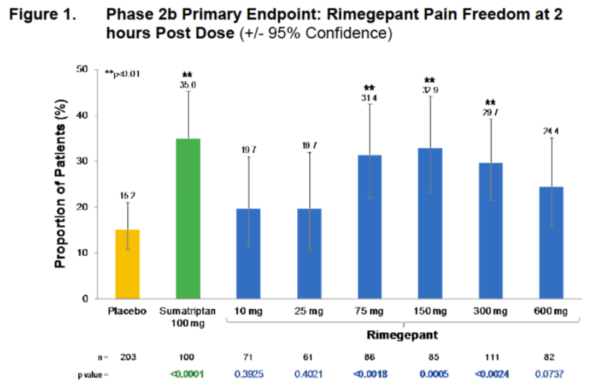
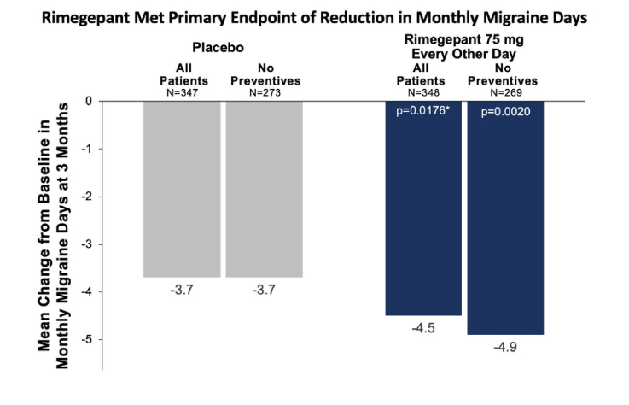
Rimegepant

Slide 35
Ubrogepant

Slide 36
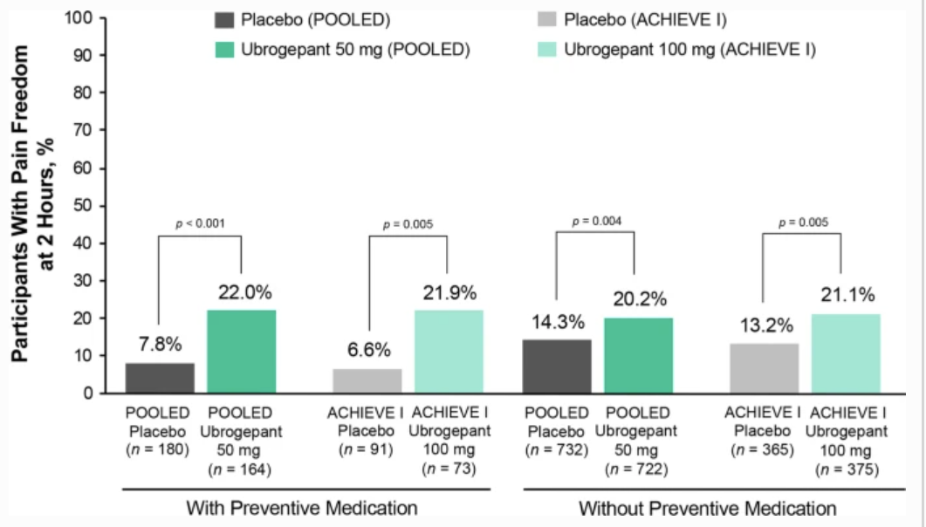
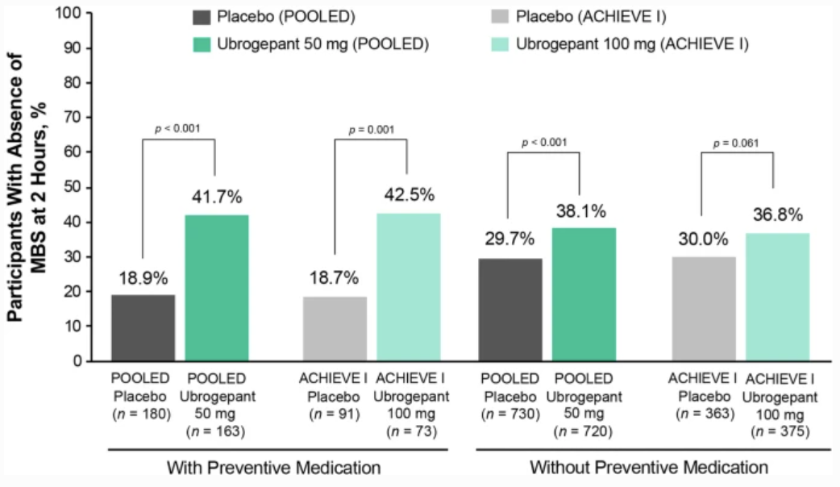
Ubrogepant

Slide 37
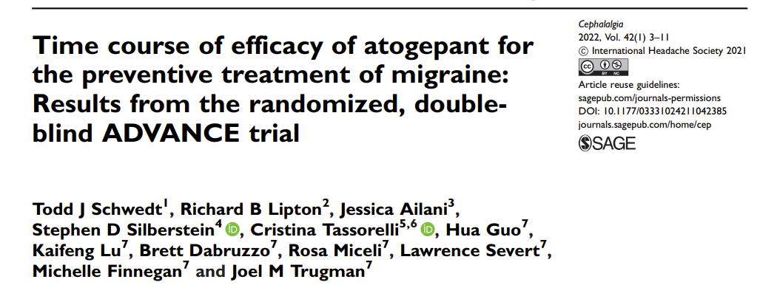
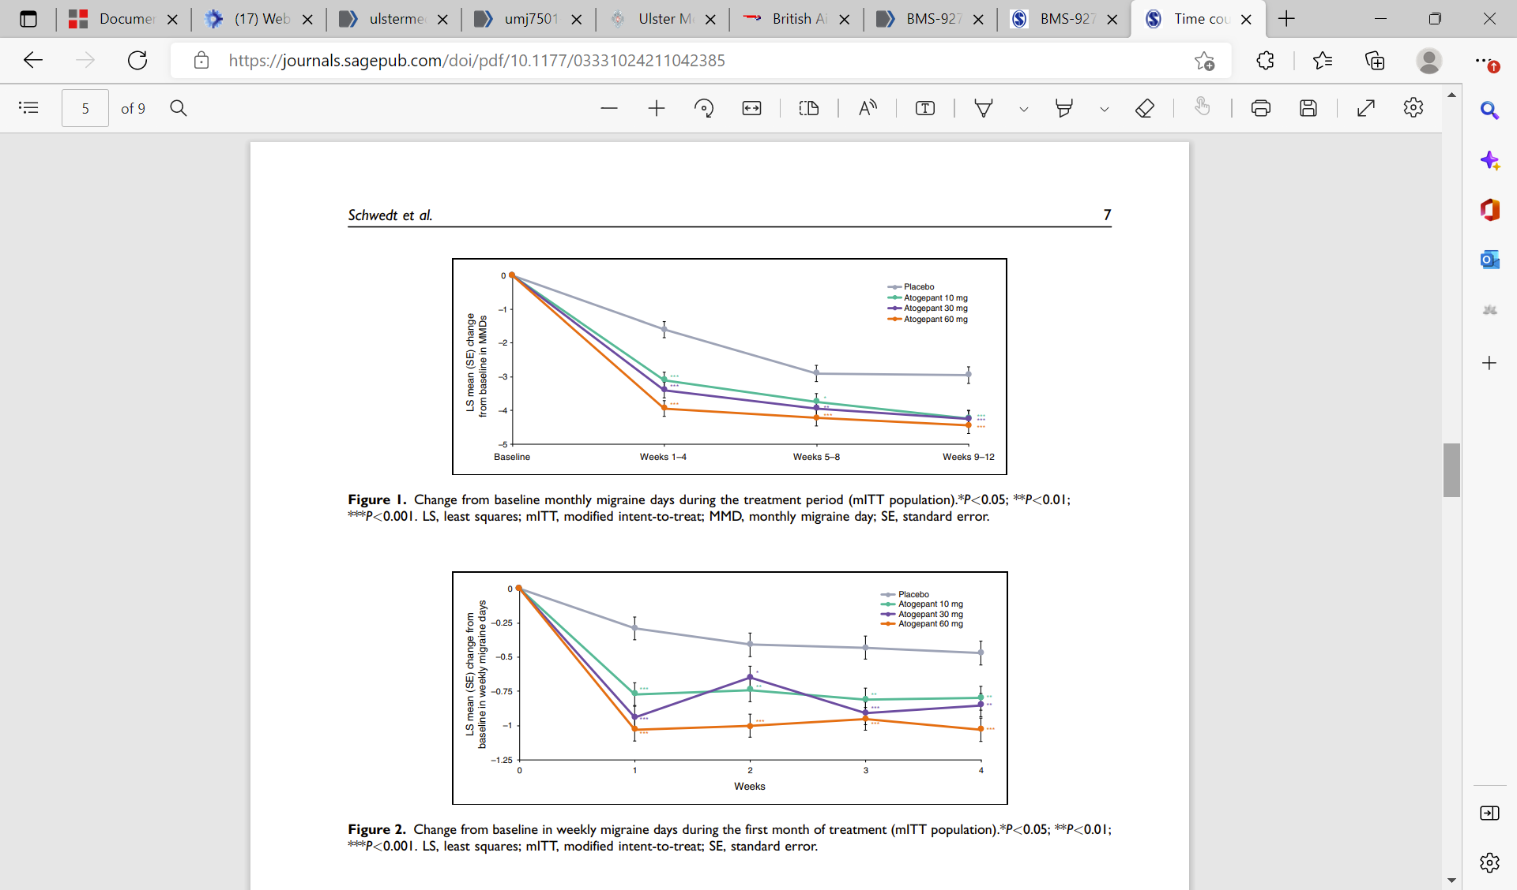
Atogepant

Slide 38
Future directions: other systems
descending antinociceptive systems may be predominantly dopaminergic and orexinergic
there is a growing evidence base for the role of the hypothalamus in the pathophysiology of migraine
  manipulation of orexinergic processing produces differential effects on trigeminal mediated pain
  orexin A is anti-nociceptive, while orexin B is either ineffective or pro-nociceptive dependent on the route of administration
population genetic studies implicate genes that are involved with glutamate signalling in migraine, and gene mutations responsible for familial hemiplegic migraine and other familial migraine syndromes may influence glutamate signalling

Slide 39
Targeting other serotonin receptors
targeting 5-HT_{1F} receptors on neurons in the central and peripheral trigeminal system, decreases neuropeptide release and inhibits pain pathways, including the trigeminal nerve
  5-HT_{1F} receptors are highly expressed in human middle cerebral arteries and human coronary arteries, but in vitro studies suggest that 5-HT_{1F} receptors do not mediate significant vasoconstriction effects in these vessels
lasmitidan is a 5-HT_{1F} agonist
pain freedom at 2 hours:
  lasmiditan 200 mg: SAMURAI 32.2%, SPARTAN 38.8%
  placebo: SAMURAI 15.3%, SPARTAN 21.3%
significance was also noted for other lasmiditan dose groups (100 mg, 50 mg) compared to placebo
most frequently reported AEs with lasmiditan (≥2% and >placebo) were dizziness, paresthesia, somnolence, fatigue, nausea, lethargy
lasmitidan was approved by the FDA on 11/10/2019, but in 2022 Lilly decided not to apply for a licence in the UK and Europe

Slide 40
Orexins, PACAP, endocannabinoids
unfortunately a single clinical trial (of the orexin receptor antagonist filorexant) failed to show any effect in migraine prophylaxis
pituitary adenylate cyclase-activating polypeptide (PACAP) is expressed in the trigeminovascular system and has been implicated in migraine pathophysiology
  infusing PACAP triggers migraine-like headaches in human subjects
the PAC1 receptor has been identified as a receptor which binds the PACAP molecule with high affinity
  AMG 301, is a PAC1 receptor selective antagonist is in Phase II studies
  in preclinical studies, AMG 301 has shown responses comparable to those observed with triptans
the endocannabinoid anandamide is metabolised by FAAH (fatty acid amide hydroxylase) – FAAH levels may be higher in migraine patients
  early POC studies of FAAH inhibitors for prevention show promise

Slide 41
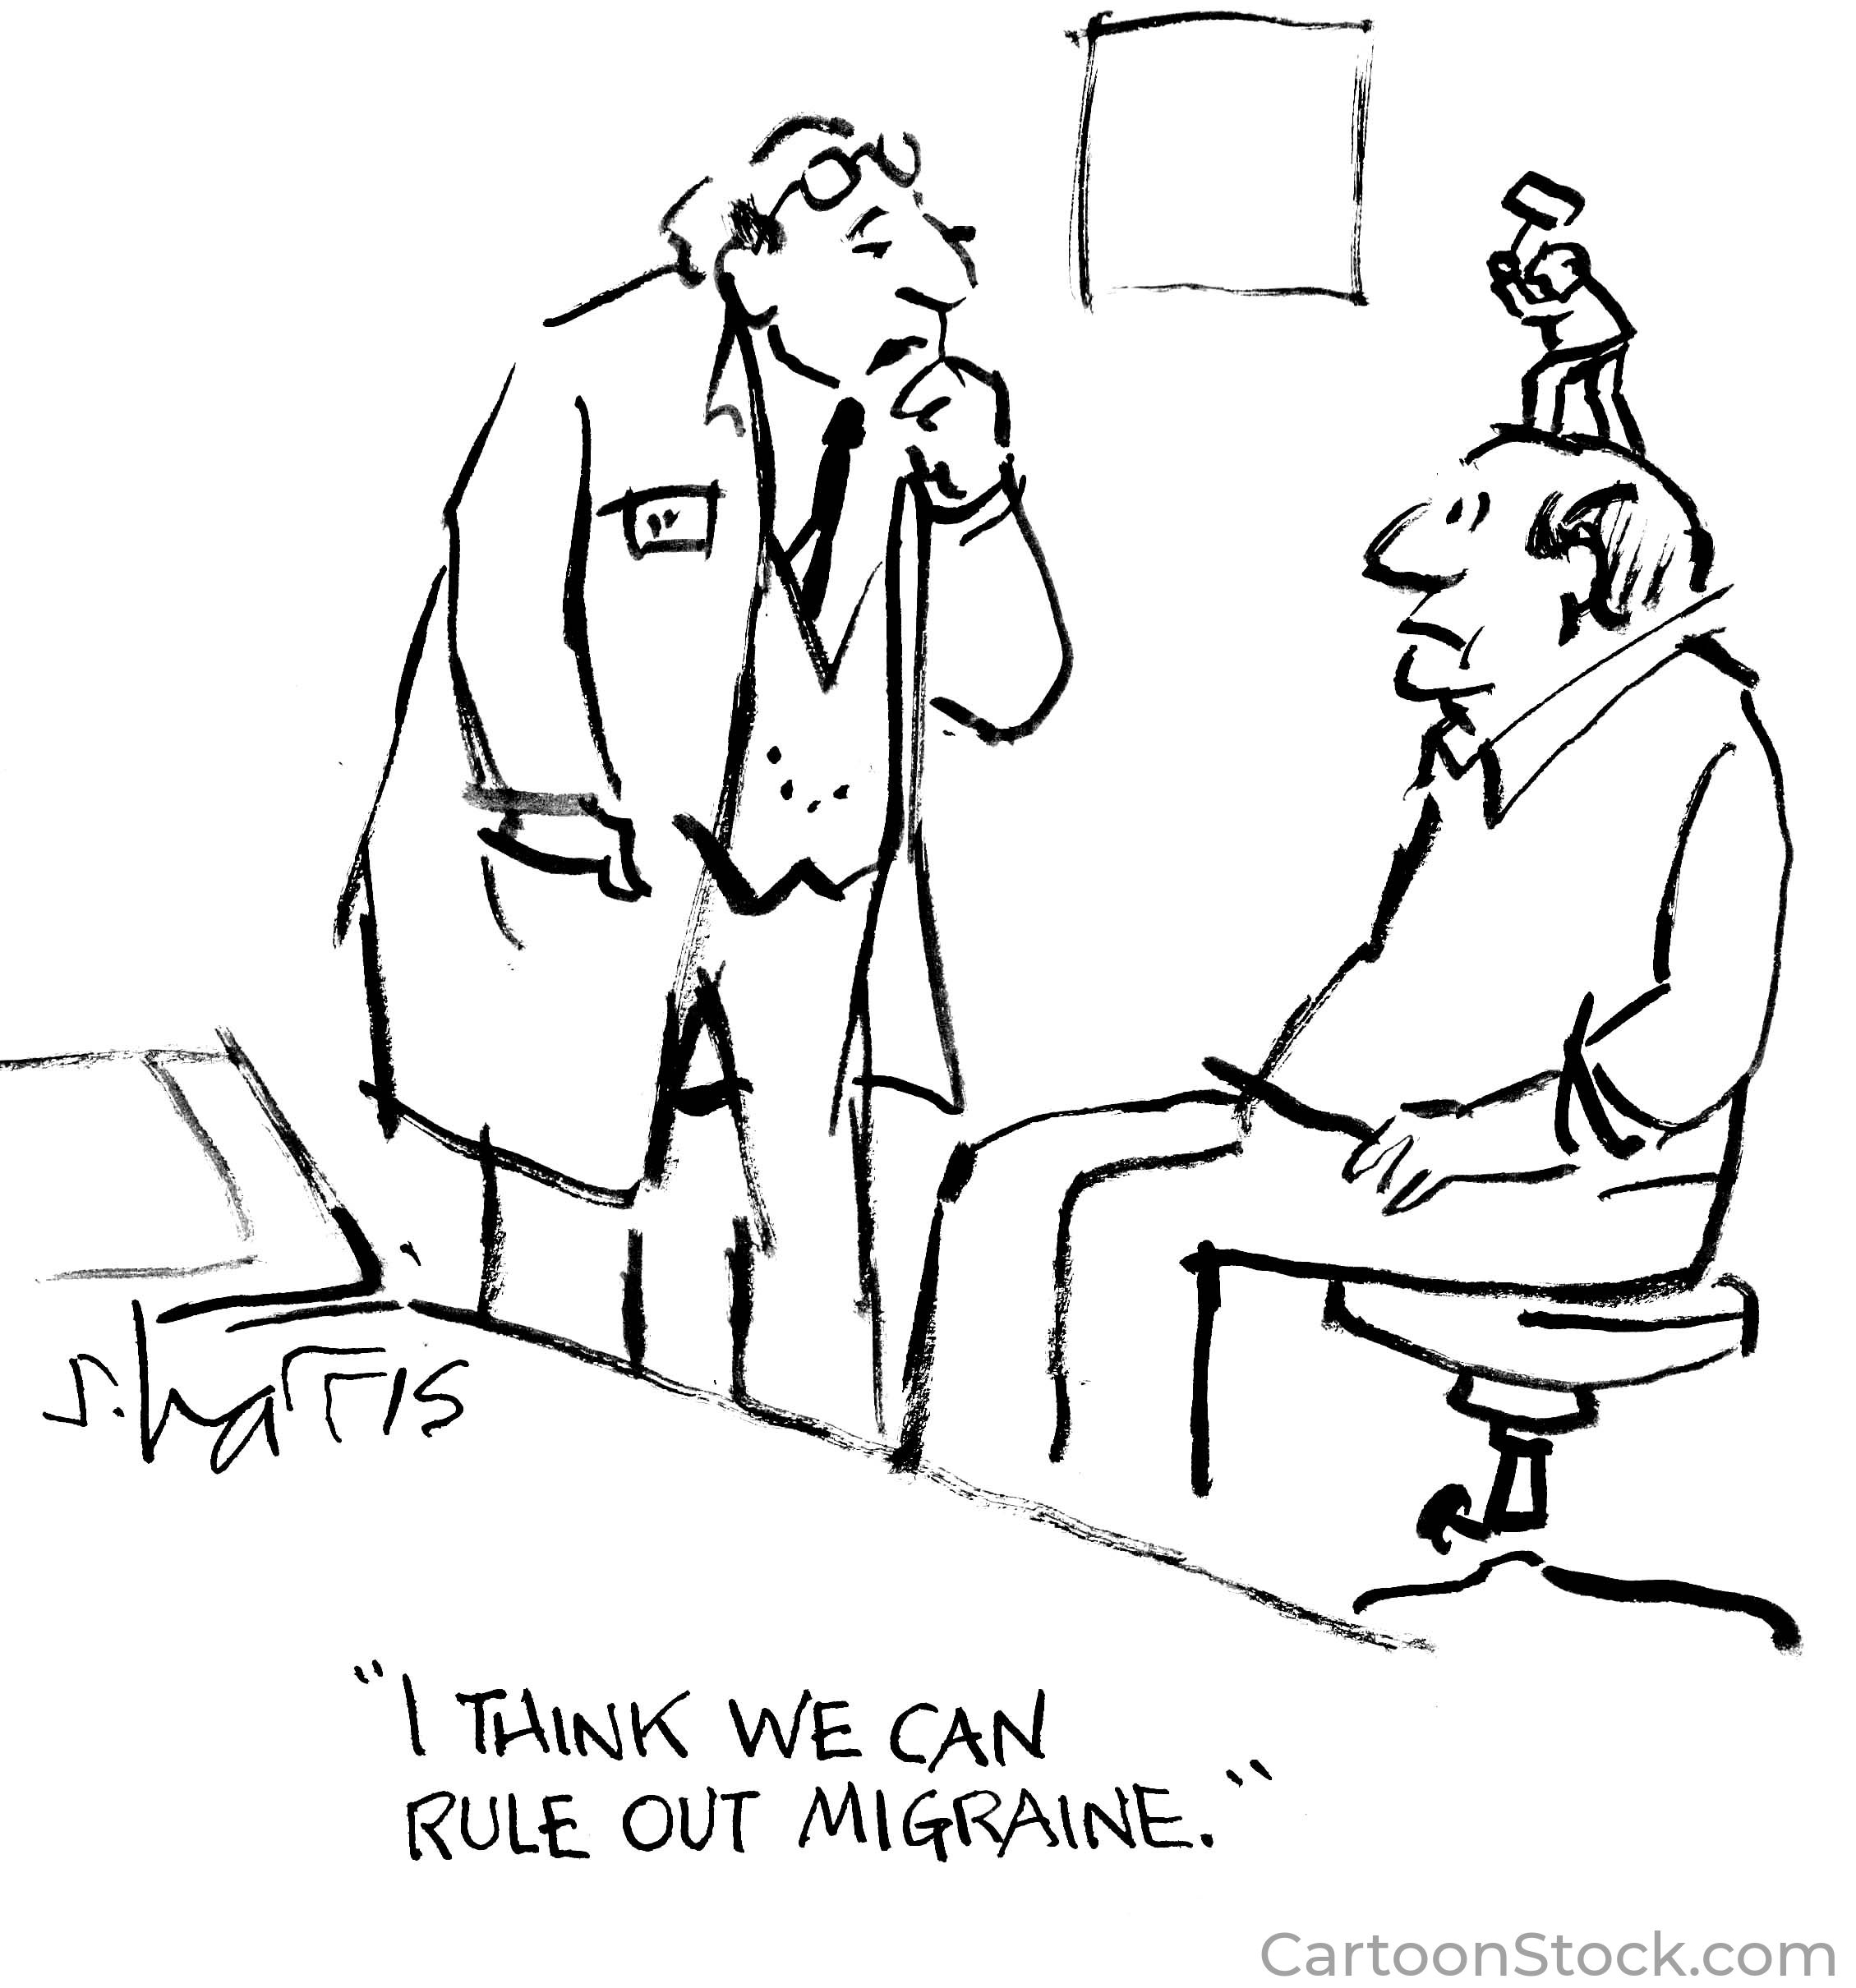
Thank you

